Slide 1




Tennessee Childhood Lead Poisoning Prevention Program (TN CLPPP)
What to do for Patients with an EBLL

Slide 2
How frequently is a capillary sample confirmed
as an elevated blood lead level(EBLL)?*
Year | # Elevated Initial Capillary Screenings | # Elevated Initial Capillary Screenings CONFIRMED | Confirmation Rate
2023 | 2,170 | 377 | 17.40%
2022 | 879 | 163 | 18.50%
2021 | 594 | 150 | 25.30%
2020 | 805 | 201 | 25.00%
2019 | 1,033 | 270 | 26.10%
2018 | 906 | 262 | 28.90%
*Data for children aged 0-72 months

Slide 3
Capillary Sample of 3.5 µg/dL or Higher
Step One:
Venous
Confirmatory Test
Conducted
Screening Test Result (µg/dL) | Time to Confirmatory Test
3.5 – 9 | 1 – 3 months
10 – 44 | 1 week – 1 month
45 – 59 | 48 hours
60 – 69 | 24 hours
≥ 70 | Urgently, as an emergency test
* Confirmatory testing can be performed same day and should be considered when working with families who are non-compliant with recommended services.

Slide 4
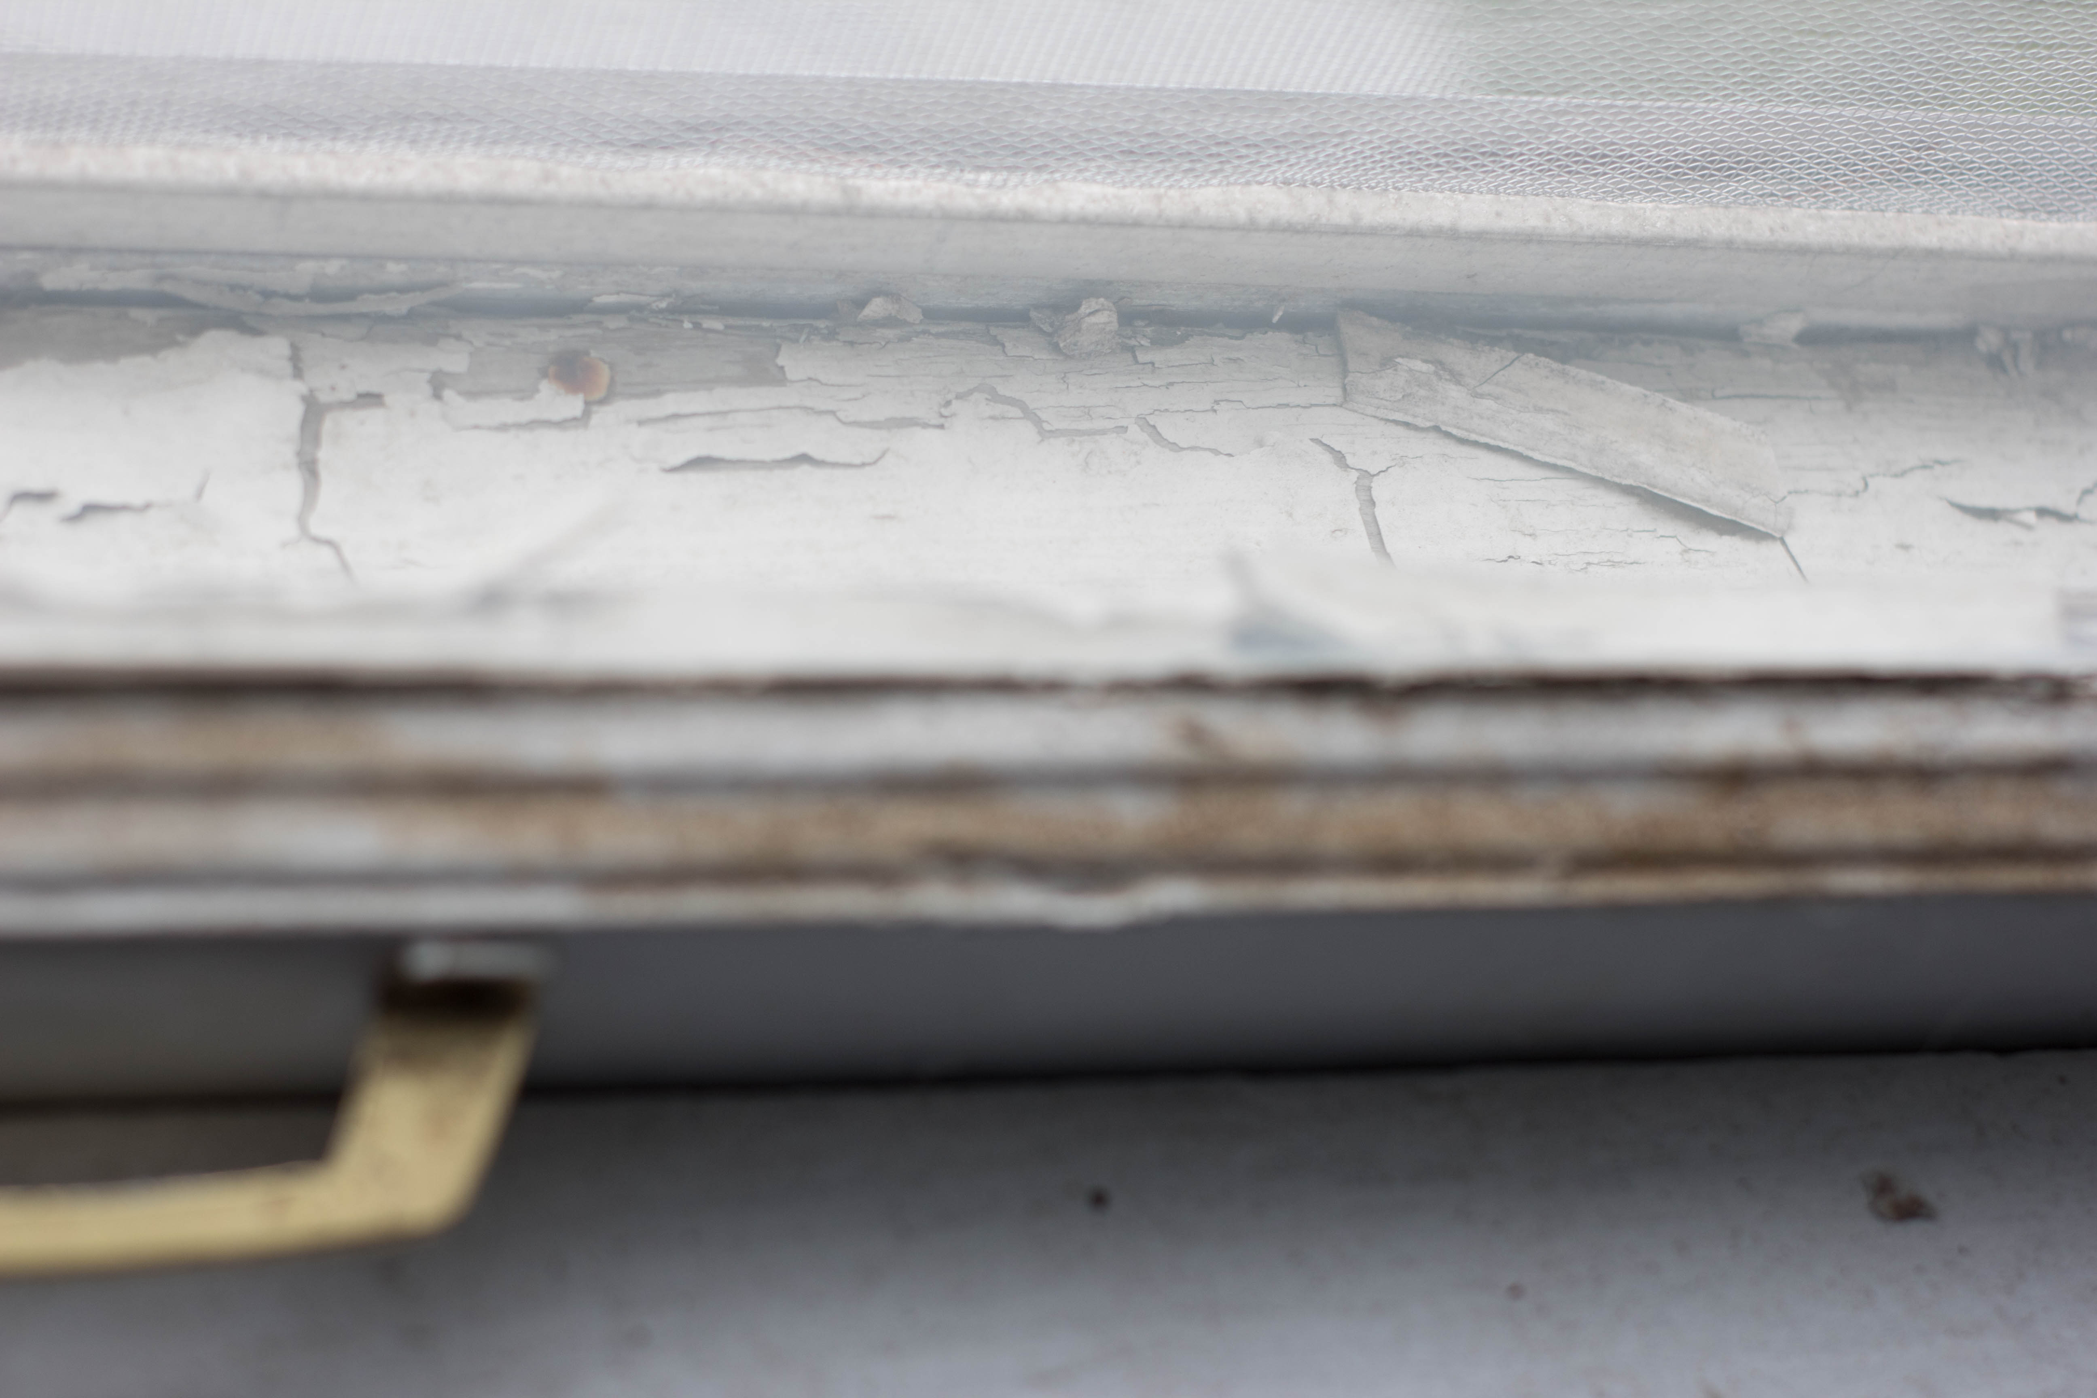

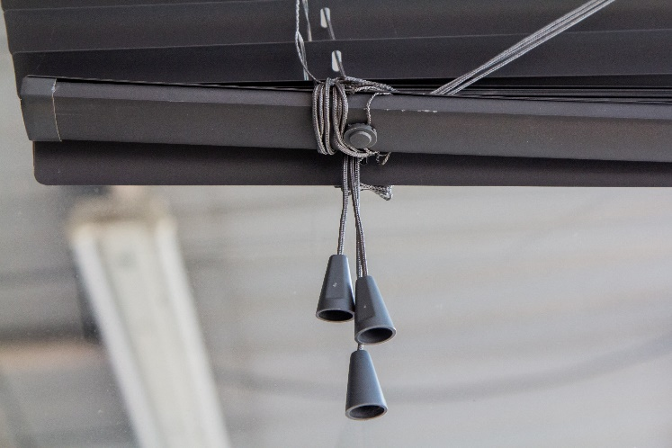
Patient with a Confirmed EBLL?
Determine the child’s lead exposure source.
Discuss solutions for source removal, reduction, or avoidance.
The Risk Assessment Questionnaire may help pinpoint the lead source(s). As necessary, include questions about the child’s playthings.
Step Two:
Parent/Guardian
Consulted

Slide 5
Case Management
Step Three:
Follow-Up
Test
Conducted
Venous Blood Lead Level (µg/dL) | Early Follow-Up (first 2-4 tests after identification) | Late Follow-Up (after BLL begins to decline)
3.5 – 9 | 3 months | 6 – 9 months
10 – 19 | 1 – 3 months | 3 – 6 months
20 – 24 | 1 – 3 months | 1 – 3 months
25 – 44 | 2 weeks – 1 month | 1 month
≥ 45 | As soon as possible | As soon as possible
Some case managers or PCPs may choose to repeat blood tests on all new patients with EBLLs within a month to ensure the BLL is not rising more quickly than anticipated.

Slide 6
Case Management (TN CLPPP)
The TN CLPPP surveillance system alerts lead nurse case managers at the TN Department of Health when a child is confirmed with a blood lead level of ≥3.5 µg/dL.
You will receive faxed reminders regarding follow-up testing
guidelines if tests are not received. The TN CLPPP case management staff is also your resource regarding medical management questions/concerns.

Slide 7
TN CLPPP Guidelines for Recommended Actions for Children Based on Blood Lead Value
Refer to the TN CLPPP Guidelines for recommendations:
https://www.tn.gov/content/dam/tn/health/documents/Oct2022CLPPP%20Screening%20GuidelinesFINAL.pdf
Page two of the guidelines also has instructions on how not to test as well as links to additional resources
Contact the Tennessee Poison Control Center for toxicologist consultation: 1-800-222-1222

Slide 8

Potential Action for Blood Lead Level of ≥15 µg/dL:
Environmental Investigation
You may request a state-funded environmental investigation to determine a child’s lead exposure source, when his/her BLL is ≥15 µg/dL or has continued follow up tests that continue to escalate.
[Please see the Environmental Investigations fact sheet for complete information.]

Slide 9
Early Intervention Services
Children with developmental delays related to lead poisoning or an elevated venous test may be eligible for educational intervention services through TEIS (TN Early Intervention System).
For questions, or to make a referral:
tn.gov/education
1-800-852-7157

Slide 10
Referral to CHANT:
Community Health Access and Navigation in Tennessee
The Children's Special Services (CSS) program is now part of an integrated model of care coordination called Community Health Access and Navigation in Tennessee, or CHANT. CHANT is available for families through all county health departments. The nurse case managers at the TN Department of Health will automatically refer a child with a blood lead level >3.5 µg/dL to CHANT.
https://www.tn.gov/health/health-program-areas/fhw/early-childhood-program/chant.html

Slide 11
TN CLPPP Resources
Your Regional Coordinator or the state case management staff is available for consultation on medical issues.
If you would like regional medical consultation and need contact information, contact: PbforMDhelp@utk.edu
All links mentioned in this presentation are listed on the website below.

